Slide 1

Dynamical systems reading group – week 2
Matthew Harvey

Slide 2

Week 2: One-Dimensional Flows and Neuronal Excitability
Code available:
https://github.com/matt-j-harvey/Dynamical_Systems_Reading_Group
● Readings:
Strogatz Ch. 2
● Topics:
Recap
Simulating dynamical systems
Linear Stability analysis
The Leaky Integrate-and-fire model
● Computational exercise:
Writing a function to find fixed points of a 1D system numerically.
Notes:
Dynamical system:
State [x]
Describe how state evolves over time
The collection of all the possible states are the state space / phase space.
At every state we can calculate the derivative to produce a “vector field / phase portrait” – this can help us understand the behaviour of the system.
At certain points the derivative might be 0 – these are “fixed points”
Fixed points can be either “stable” – if nearby states converge to them
“unstable” nearby points are repelled from them.

Slide 3
Cheeky recap

Slide 4
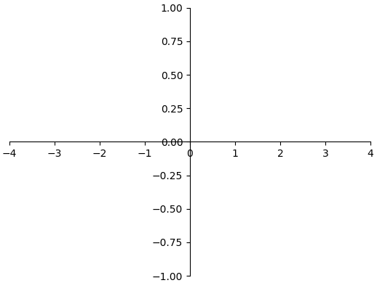
Dynamical System
Example
State space / phase space
(real numbers)

Slide 5
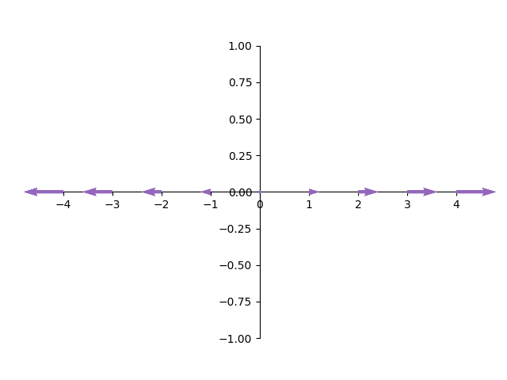
Dynamical System
Example
Fixed point (derivative is 0)
Unstable
(nearby points do not converge to it)
Vector field / phase portrait
State space / phase space
(real numbers)

Slide 6
Simulating a dynamical system

Slide 7
Simulating a dynamical system
1.) Pick an initial state
2.) Calculate the derivative
3.) Multiply this derivative by the timestep (0.1)
4.) Add the derivative to the current state to get the new state
5.) Repeat step 2 again with the new state!
1
1.1
1.21
1 x 0.1 = 0.1
1.1 x 0.1 = 0.11

Slide 8
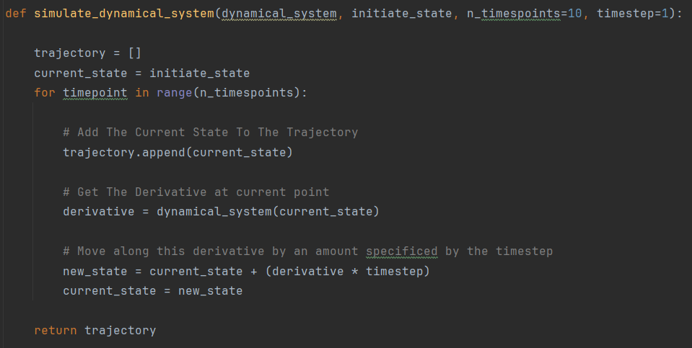

Slide 9
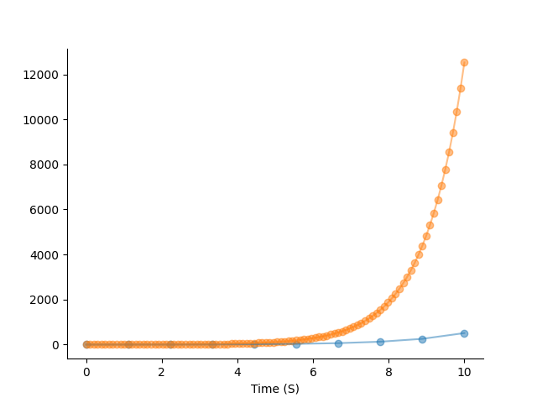

Why do we need a timestep?
Start at 1
Simulate for 10 Seconds
10 steps of 1s
100 steps of 0.1s
What on earth is going on?

Slide 10
When we simulate iteratively, each iteration we “jump” by the timestep
However, in reality the derivative may be changing continuously over this period
If we have a timestep which is too big – our simulation will be inaccurate

Slide 11
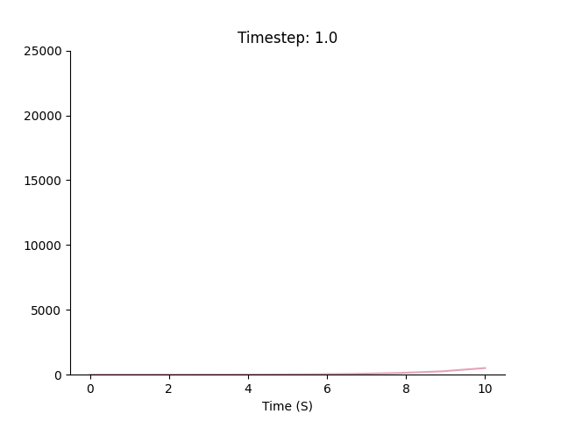

Slide 12
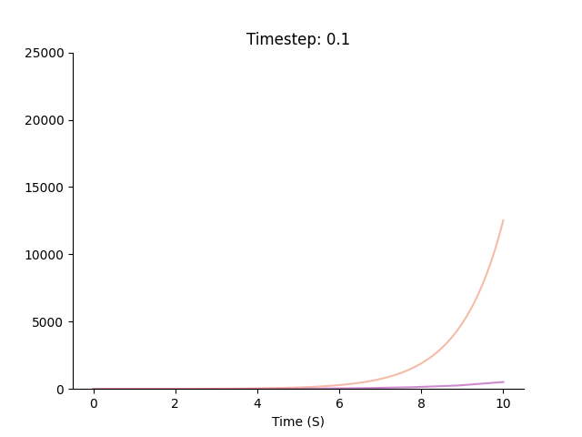

Slide 13
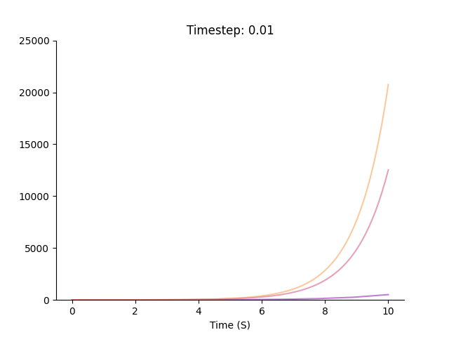

Slide 14
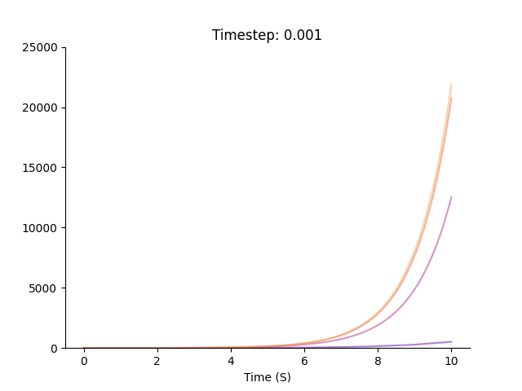

Slide 15
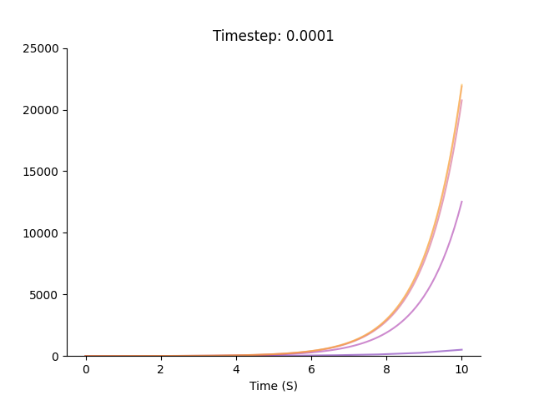

Slide 16
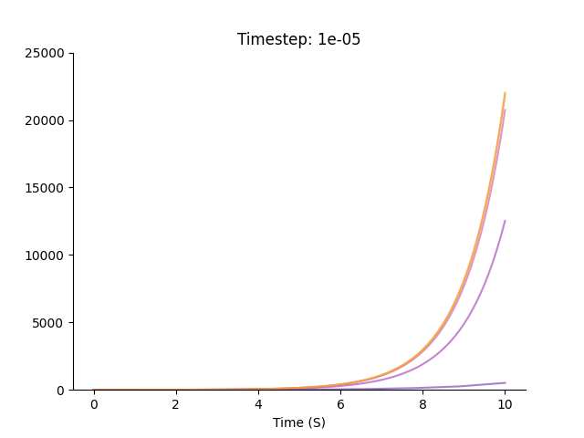

Slide 17
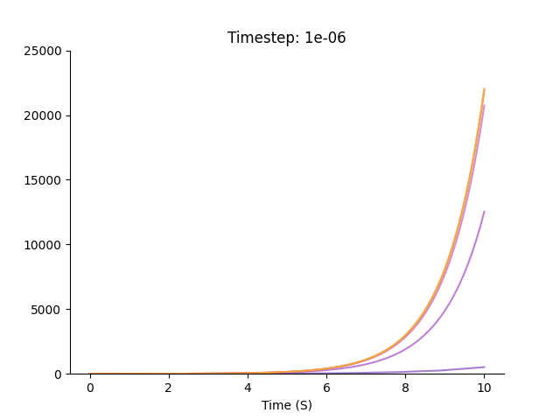

Slide 18
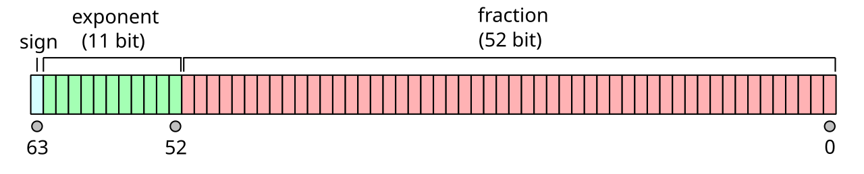
If the timestep is small enough, the simulation results will be a good approximation of the truth
So - let’s just make it really, really tiny right?
Computers cannot represent numbers with arbitrary precision – they can only go up to so many decimal points
If the change is extremely small – the computer will start making errors representing these number.

Slide 19

If my timestep is too big – my simulation will be wrong, because the system will be changing in between my jumps
If my timestep is too small – my simulation will be wrong, because computer are not infinitely precise, they make errors on very, very small numbers.
It needs to be just right..

Slide 20
Linear Stability Analysis

Slide 21
Some fixed points are more stable / unstable than others.
A little bit unstable
A little bit stable
Very unstable!
Very stable
The derivative of the function around a fixed point tell us how stable it is
negative derivative = stable
positive derivative = unstable

Slide 22
Clarify the layers:
function (x)
derivative of x with respect to time
(which is 0 at fixed points)
Derivative of the function
Tell us if the point Is stable
(2nd derivative of x)
State (x)

Slide 23
Sometimes we can calculate the derivative analytically
Sometimes we cannot
In these cases we can try to estimate the derivative numerically:
Little step

Slide 24
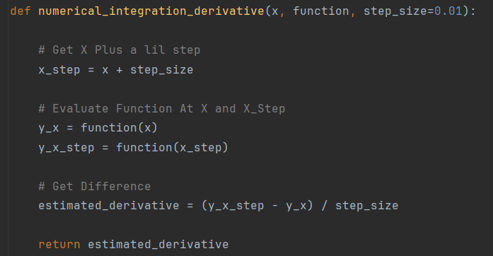

Slide 25
The leaky integrate and fire model

Slide 26
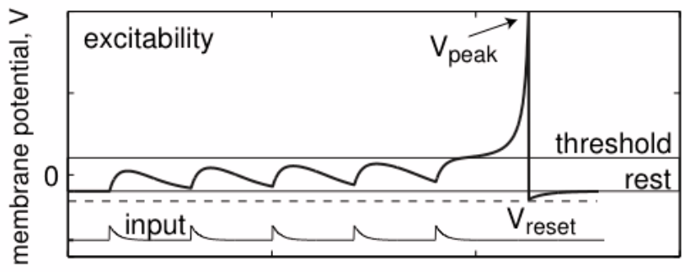
What do I want?
1.) A model for how the voltage across a neuron's membrane changes over time
2.) I want to be able to inject current in and change this voltage
3.) If the voltage goes over a certain threshold – I want it to “spike”
4.) In the absence of any input, I want the voltage to return to an “equilibrium voltage”

Slide 27
How about a dynamical system!?
well, that’s no good…..

Slide 28
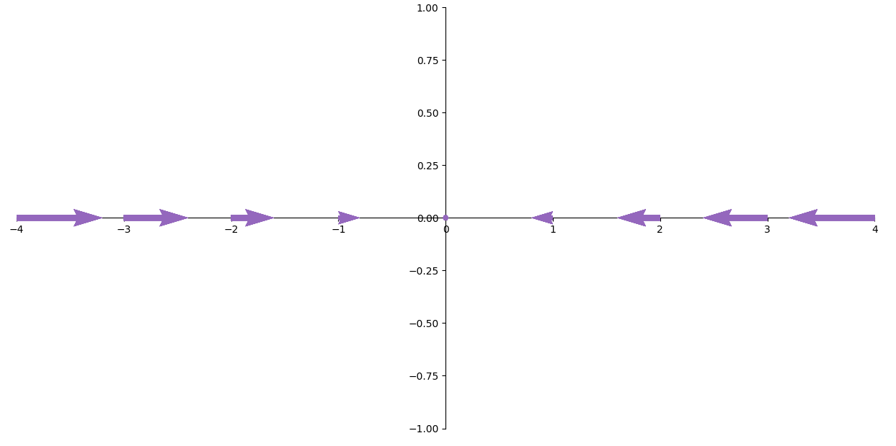
What if we subtract the current voltage….
That’s a little better

Slide 29
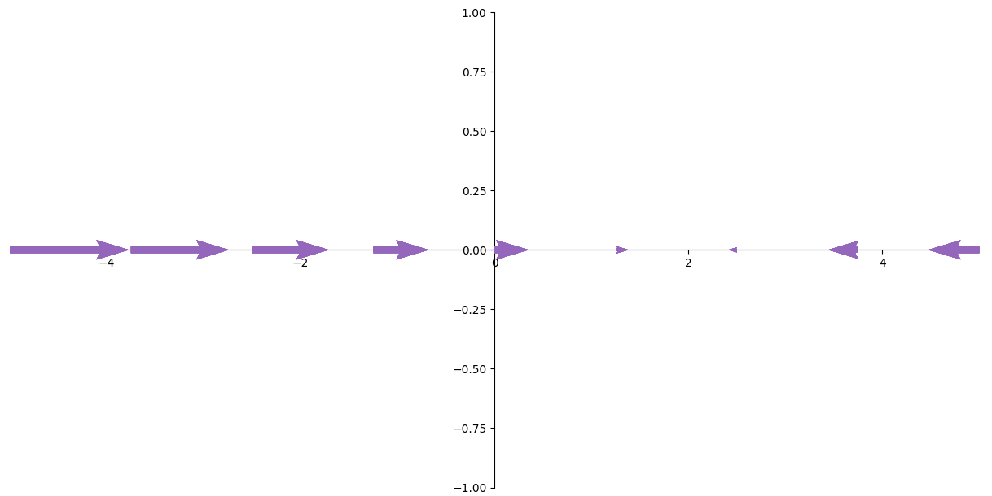
Add a term to determine the equilibrium voltage
That’s a little better again

Slide 30
Okay, but HOW leaky?
Small (not very leaky)
Big (very leaky!)

Slide 31
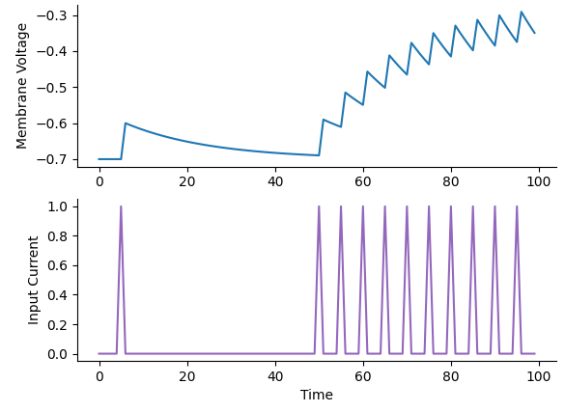
Now let’s inject some current!

Slide 32
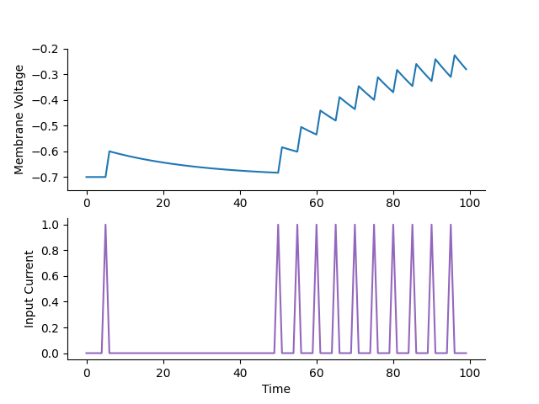
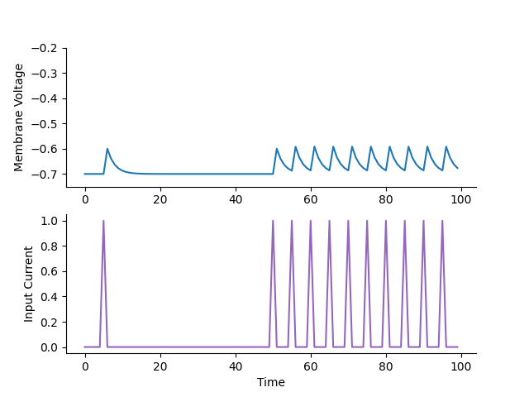
By altering the leak conductance, we change how current is integrated
gl = 0.4
gl = 4

Slide 33
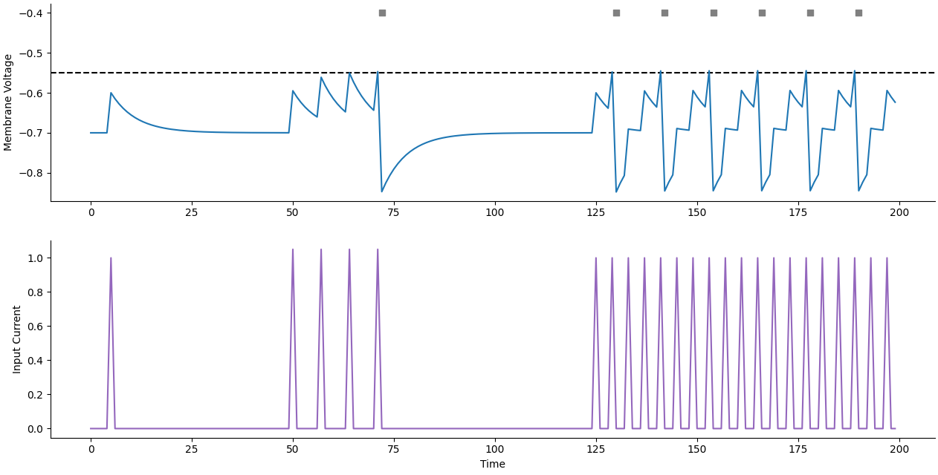
Add in the spiking - (basically, cheat with computers)
At each timepoint:
  If voltage >= Threshold voltage
  Record a spike time – and subtract some voltage

Slide 34
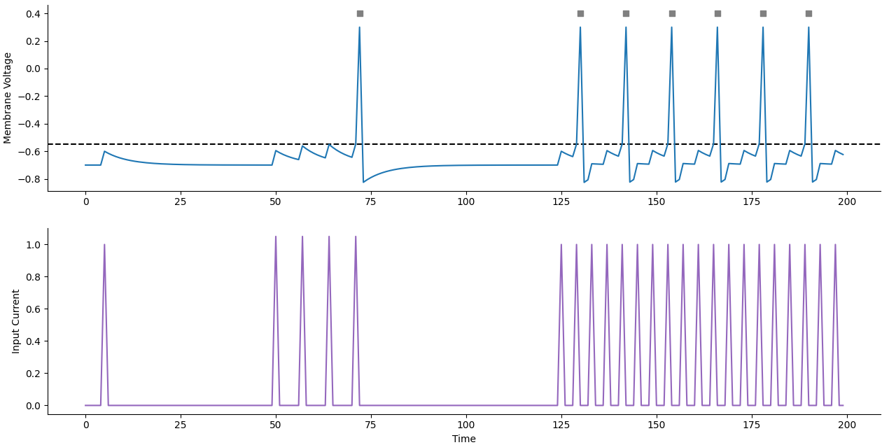
Spiking behaviour
We can then go through later and change the voltage to 0.3 at the spike times…

Slide 35
def simulate_lif_neuron(model, input_currents, timestep=0.1, n_timepoints=100, equilibrium_voltage=-0.7, leak_conductance=0.5, threshold_voltage=-0.55):
membrane_voltage = np.zeros(n_timepoints)
spike_times = []
current_voltage = equilibrium_voltage
for timepoint in range(n_timepoints):
# Check If Voltage Above Threshold
if current_voltage >= threshold_voltage:
spike_times.append(timepoint) # Record Spike
current_voltage = current_voltage -0.3 # Reset the neuron by subtracting the threshold voltage
# Otherwise Compute the voltage using our dynamical system
elif current_voltage < threshold_voltage:
# Get Input Current At This Timepoint
timepoint_input_current = input_currents[timepoint]
# Get Derivative
derivative = model(current_voltage, timepoint_input_current, equilibrium_voltage=equilibrium_voltage, leak_conductance=leak_conductance)
# Multiply By Timestep
derivative = derivative * timestep
# Add To Current voltage To Get New Voltage
new_voltage = current_voltage + derivative
# Set Current Voltage To New Voltage
current_voltage = new_voltage
# Add Current Voltage To Trajectory
membrane_voltage[timepoint] = current_voltage
return membrane_voltage, spike_times

Slide 36
Finding the fixed points of a dynamical system

Slide 37
Dynamical System
Fixed points are where this function = 0
Finding the points of a function where it = 0 is known as “root finding”

Slide 38
Newton–Raphson method
Take an initial guess
Get the tangent
Find X-intercept of the tangent
Use this as the next guess, and repeat
Stop when I basically stop moving

Slide 39
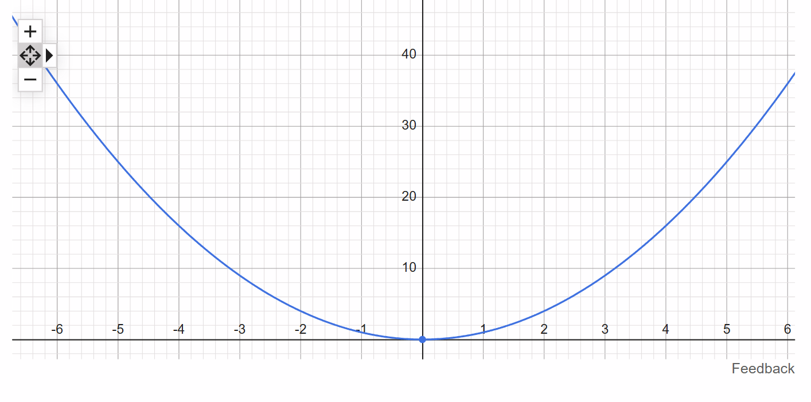
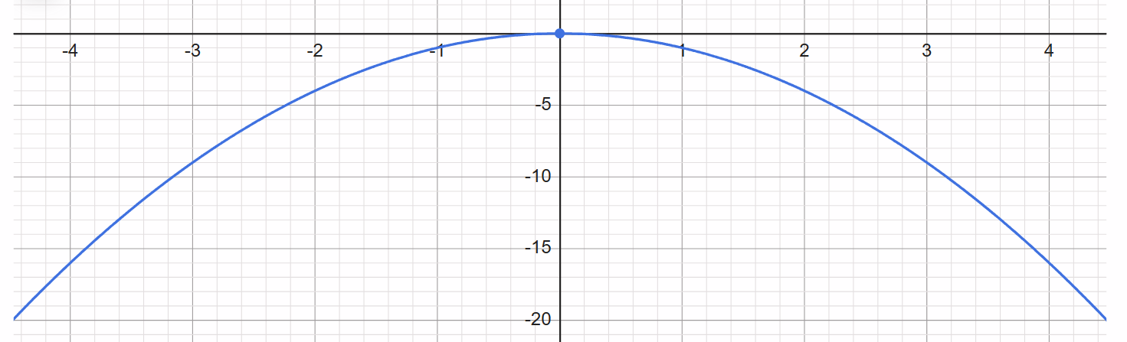

Slide 40
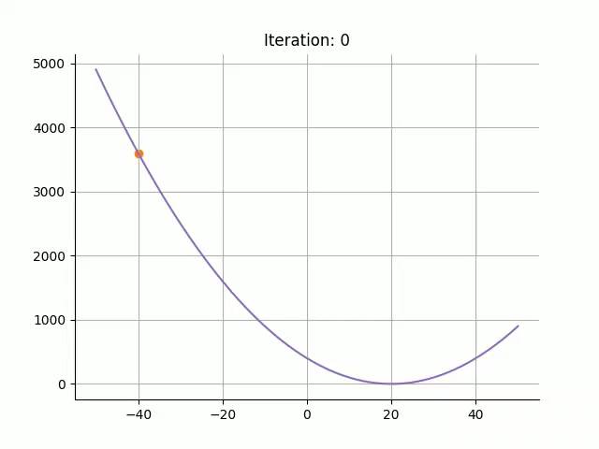

Slide 41
def newton_raphson_method(function, initial_guess, tolerance=0.01, max_iterations=5000):
x = initial_guess
guess_list = []
for iteration in tqdm(range(max_iterations)):
# Add Current Guess To List
guess_list.append(x)
# Evaluate Function At Initial Guess
y = function(x)
# Get Derivative At Initial Guess
derivative = numerical_integration_derivative(x, function)
# Get Y Intercept:
c = y - (derivative * x)
# Get X Intercept
x_intercept = (0 - c) / derivative
if np.abs(x - x_intercept) < tolerance:
guess_list.append(x_intercept)
return x_intercept, guess_list
else:
x = x_intercept
print("Error! Did not converge!")
return None

Slide 42
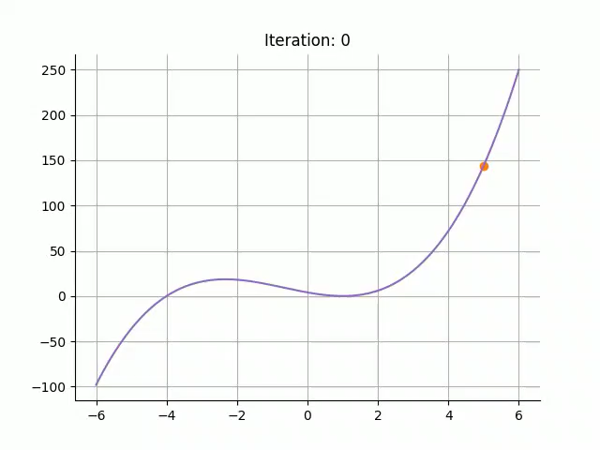
Numerical methods typically only find local minima!
Make sure you try a number of initial positions

Slide 43
Dynamical!
Code available:
https://github.com/matt-j-harvey/Dynamical_Systems_Reading_Group
● Readings:
Strogatz Ch. 2
● Topics:
Recap
Simulating dynamical systems
Linear Stability analysis
The Leaky Integrate-and-fire model
● Computational exercise:
Writing a function to find fixed points of a 1D system numerically.
Notes:
Dynamical system:
State [x]
Describe how state evolves over time
The collection of all the possible states are the state space / phase space.
At every state we can calculate the derivative to produce a “vector field / phase portrait” – this can help us understand the behaviour of the system.
At certain points the derivative might be 0 – these are “fixed points”
Fixed points can be either “stable” – if nearby states converge to them
“unstable” nearby points are repelled from them.

